Slide 1




Presented by - Group –no 28
Arkaprabha De – 11
Arnav Sharma – 12
Arpan Chatterjee - 13
Atanu Paul-14
Ayana Roy -15
6. Ayush Kumar Gore -16
7. Debadree Sekhar Das - 17
8. Debojyoti
9. Debnil Dey-19
10. Deepmalya Koley -20

Slide 2
INTRODUCTION
“Imagine being called over to preside over two crucial events at the same time. Or imagine facing a decision where you’d want a second version of yourself — not someone trained on millions of generic data points, but someone who thinks like you, reasons like you, and represents you exactly.”
The Gap - Reality Today: “Today’s AI assistants cannot bridge this gap. They process information, but they don’t embody your cognition, decision-making style, or emotional context. They assist — but they don’t extend you.”
The Core Problem: “What we lack is an AI that functions as a parallel self: a cognitive twin that can act independently yet in alignment with who we are, enabling true personalization and distributed presence. "over

Slide 3
The Solution
Meet NeuralTwin – Your Cognitive Clone !! It is an AI system designed to replicate human cognition into an interactive form. It merges cognitive modeling with immersive physical design, capturing memories, decision-making styles, and personality traits.
Objectives
It learns your reasoning, decision-making, and behavior through personalized training.
Answers, presents, and converses in your tone, face, and expressions.
Can represent you in multiple contexts simultaneously — like a second you.
Starts with simple decision-making and expands to complex reasoning, automation, and personalization.

Slide 4
Author(s) & Year | Work | Key Contribution / Relevance to Your Project
Madaan et al., 2024 | MemGPT: Towards LLMs as Operating Systems | Introduces hierarchical memory management for LLMs, directly supporting your static + dynamic memory system.
Xiong et al., 2024 | LongMem: Augmenting LLMs with Long-Term Memory | Enhances long-term memory recall and personalization aspect in AI models.
Wu et al., 2022 | PETAL: Personalized Dialogue with Transfer RL | Uses reinforcement learning for personalized dialogue, aligning with your RL-based mimicry approach.
Liu et al., 2024 | Human Digital Twin: A Survey | Provides core reference for digital twin approaches, which you extend into cognitive + behavioral identity.
Frankle et al., 2023 | Sustainable LLM Inference for Edge AI | Relevant to your system since it runs on Raspberry Pi with cloud support, ensuring sustainable inference.
Gemmell et al., 2010 | MyLifeBits: A Personal Database for Lifelogs | Foundational lifelogging concept that you expand into AI-driven reasoning + holographic visualization.

Slide 5
-requirements.txt
Hardware | Software
Raspberry Pi 4 | Python, TensorFlow/PyTorch
Pepper ghost Holograph Module | MediaPipe
Transparent Fiber Brain casing | neo4j Knowledge Graph &Chroma DB
Pi-cam | FastAPI
Microphone | HeyGen, ElevenLabs
Speaker | OpenCV
Power Supply | pyaudio,pygame

Slide 6
METHODOLOGY
Step | Process | Description
1 | Data Collection & Preprocessing | Gather ~15–20 personalized Q&A samples/day, clean and structure data for training, labelling
2 | Build Knowledge Base | Construct a knowledge graph for semantic search and contextual reasoning (beyond keywords).
3 | Cloud-based AI Training | Train models to classify and cluster decision patterns, focusing on behavioral mimicry.
4 | Edge Deployment | Deploy trained model to Raspberry Pi 4 for low-latency inference and portability.
5 | Hardware + Holographic Integration | Integrate with Pepper’s Ghost holographic system for projecting AI avatar with gestures & expressions.
6 | GUI Development | Build an interactive user interface (avatar front-end + landing page for communication).
7 | Testing & Optimization | Use Reinforcement Learning & Q-learning to refine reasoning and enable adaptive, multi-step cognition.

Slide 7
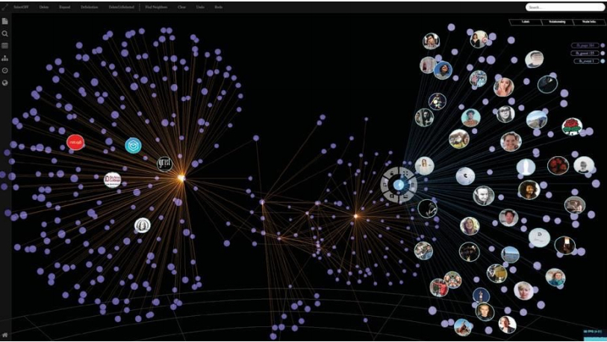
IMPLEMENTATION STEPS
Phase 1: Data & Knowledge Foundation
Daily Cognitive Surveys (binary/multiple choice/ open-ended reasoning) + static profile data.
Knowledge Graph + Vector DB to organize memories and context – for semantic similarity search
Knowledge Graph
image credits: neo4j/knowledge/graph

Slide 8
IMPLEMENTATION STEPS
Phase 2: Cognitive Skeleton (Decision Trees)
Train Decision Tree classifiers on survey data for interpretable rules.
Captures your base heuristics & binary reasoning patterns.
Algorithm : CART (Classification and Regression Trees)
where pi​​ is the probability of class i in dataset D.
# Remark
Used for both classification and regression task. It minimizes Gini impurity for classification and MSE for regression with pruning technique to prevent overfitting.

Slide 9
IMPLEMENTATION STEPS
Policy Gradient (REINFORCE / PPO)
Directly optimizes the policy (the probability distribution over actions).
More natural for complex decision-making (language, conversation, multi-step reasoning)
PPO (Proximal Policy Optimization) is the gold standard in modern RL for stable training.
blog credits::https://huggingface.co/blog/deep-rl-ppo
Phase 3: Cognitive Muscle (Neural Nets + RL)
Fine-tune the LLM (meta-llama/Llama-3.2-1B-Instruct) with our data + RL feedback.
Neural network handles language, nuance, unseen scenarios.
Algorithm: Policy Gradient (REINFORCE / PPO)

Slide 10
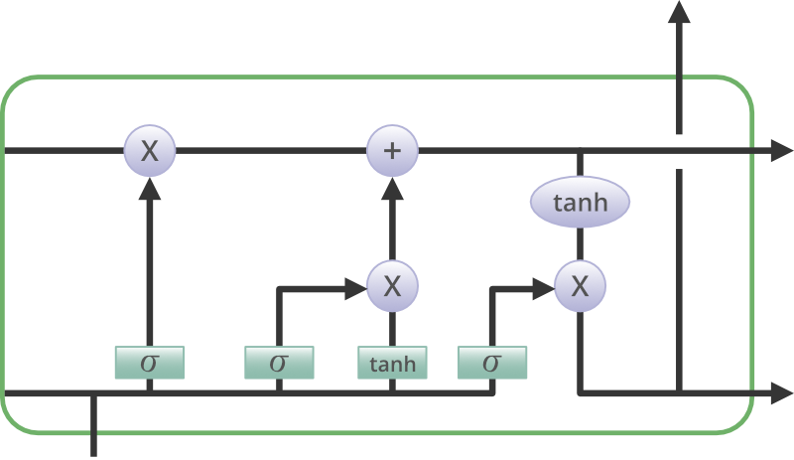
IMPLEMENTATION STEPS
Phase 4: Fusion & Avatarization
Hybrid fusion model – Decision Tree & LSTM (RNN)
Deploy as real-time interactive avatar:
Voice cloning
Face/avatar rendering
Real-time NLP-based responses.
Agentic Automation
LSTM – The Advanced RNN
image credits: geeks_for_geeks/Machine_learning/Data_Science

Slide 11
CONCLUSION & FUTURISM
Early Prototyping / Proof-of-Concept
Daily survey data successfully mapped into knowledge graph + vector DB
Initial fine-tuning shows the model adapts to personal decision patterns
Prototype avatar demonstrates basic mimicry of reasoning + responses
Advanced Prototyping / Future Projections
Cognitive Mimicry: Model predicts personal decisions with 80-85% accuracy on test cases
Adaptive Interactions: RL integration allows avatar to refine responses in real-time feedback loops and interact with user
Personalized Presence: AI clone mirrors not just knowledge, but style, reasoning & priorities
Agentic Abilities: NeuralTwin executes and automates tasks (presentations, meetings, reports) autonomously
Potential Impact
Time Multiplication: Be in two places at once (meetings, tasks)
Personalization: Unlike generic LLMs, NeuralTwin is a 1:1 reflection of you
Human-AI Symbiosis: Moves AI from “assistant” → to true extension of self

